Slide 1
System Concept
A system exits by taking input from the environment , transforming (processing) input, and release an output
A system may be decomposed (exploded) into subsystems
Output of one subsystem may become the input of other subsystems

Slide 2
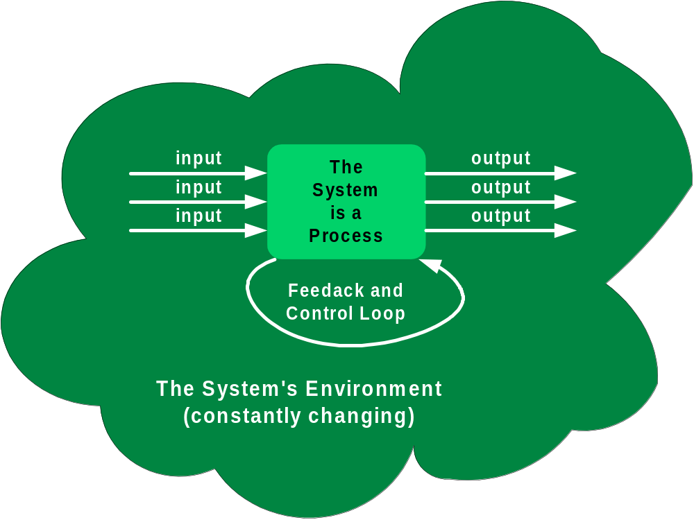
System Concept (con’dt)

Slide 3
Data Flow Diagrams
Data flow diagram: is a graphical modeling tool to depict the flow of data through a system and the work or processing performed by that system.
  What’s the system doing?
Use a limited number of symbols.
Do not depict management or operational elements of a system.

Slide 4
Notations of DFD
DE MARCO & YOURDON NOTATIONS (Textbook)
External Entity
Data Flow
Process
Data Store

Slide 5
Notations of DFD
GANE & SARSON NOTATIONS (more universal)
External Entity
Data Flow
Process
Data Store

Slide 6
Data Flow Diagram (DFD)
Key points for modeling
  How data moves through the organization
  Relationships between various data flows
  Storage of data
There are no FIXED rules about how a DFD should be developed…
There is no such a DFD call “CORRECT DFD”…
  Yours can be different than mine but both are correct.
  It is ambiguous development process (each one’s view and opinion can be different).

Slide 7
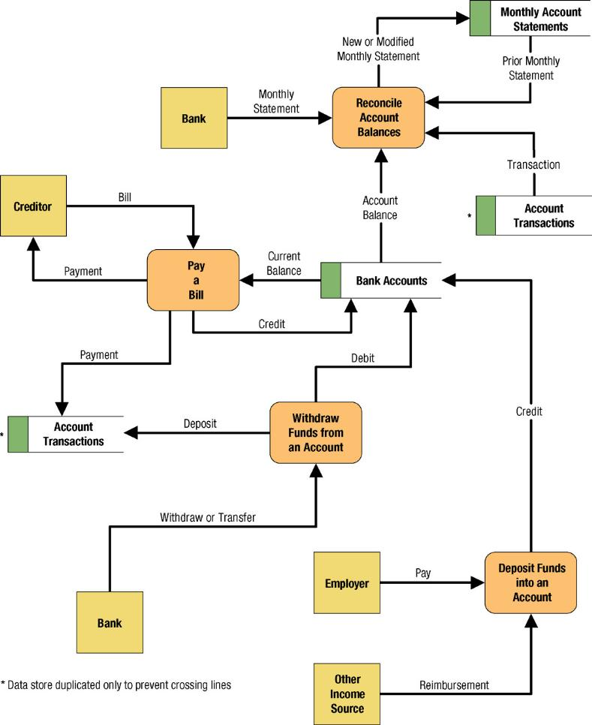
Simple Data Flow Diagram for Banking
Notes:
Teaching Notes
We have found it useful to walk through this first DFD. Don’t be alarmed if students take exception to some of the oversimplification of the illustrated problem—it can actually contribute to the learning experience.

Slide 8
Decomposition of Context Diagram
M
0
P
Context Diagram
N
M
D1
Level-0 Diagram
1
2
P
3
Level-1 Diagram
N

Slide 9
External Entities
An External Entity is a provider (source) or receiver (sink) of data and information of the system
SUPPLIER

Slide 10
External Entities …
As scope changes, external agents can become processes, and vice versa.
Almost always one of the following:
  Office, department, division inside the business but outside the system scope.
  An external organization or agency.
  Another business or another system.
  One of system’s end-users or managers

Slide 11
Data Stores
D1
Accounts Receivable
A data store is an inventory of data.
  A data store means “data at rest.”
  A data flow means “data in motion.”

Slide 12
Data Stores …
  Almost always one of the following:
    Persons (or groups of persons): e.g., customer
    Places: e.g, cash register
    Objects: e.g., product
    Events (about which data is captured): e.g., sales

Slide 13
Data Flows
DELIVERY SLIP
A Data Flow represents an input of data to a process, or the output of data from a process.
A Data Flow does not represent a document or a physical good: it represents the exchange of information in the document or about the good

Slide 14
Processes
1
Pay Bill
A Process is a work or action performed on input data flow to produce an output data flow
Use a verb/verb phrase to label the action performed by the process
A Process must have at least one input data flow and at least one output data flow.

Slide 15
How to find each one…
External Entities (EE): noun
  people/organizations/things that supply information to or use information from the system
Processes (P): verb/verb phrase
  actions/doing words
Data Flows (DF): name of data
  movement/exchange of information/data between external entities to processes, and processes to processes
Data Stores (DS): noun
  store/record information/data

Slide 16
Guidelines for Developing DFD
Develop a list of business activities
  Similar to business rules of ERD
Create the Context Diagram (first task)
  shows external entities and data flows to and from the system: conceptual DFD
Create level 0 DFD (or Diagram 0)
  shows general processes at the highest level
Create level 1 DFD (or Child Diagram)
    shows more detailed processes
Create level n-1 DFD…..

Slide 17
Context Diagram Building Procedure
Identify the system and its boundaries (the context)
Identify external entities (providers, receivers of system info)
Identify external data flows (input, output)
  However, NO DATA STORE !!!
Note: the whole system itself is a process (it receives input and transforms into output)

Slide 18
Decomposition of Context Diagram
M
0
P
Context Diagram
N
M
D1
Level-0 Diagram
1
2
P
3
Level-1 Diagram
N

Slide 19
Description of Each Level
Context Diagram: This is the highest level and represents the overall system and its interaction with its environment
Level 0 Diagram: This shows the major subsystems and their interactions
Level x Diagram: Shows the processes that make up each of the major subsystems

Slide 20
Level 0 DFD Building Procedure
Level-0 DFD
  Identify what is being done between each input and its corresponding output
  Identify the processes
  Identify external data flows between external entities and processes
  Identify internal data flows between processes and data stores
Iterate as needed
  The DFD is often drawn many times before it is finished, even with very experienced expert

Slide 21
Tips for Level 1 and Below
Decompose Level-0 processes
List source and destination of data flows to processes and stores within each DFD
Depth of DFD depends on overall system complexity
  Two processes generally don’t need lower level
  More than seven processes become overly complex and difficult to read

Slide 22
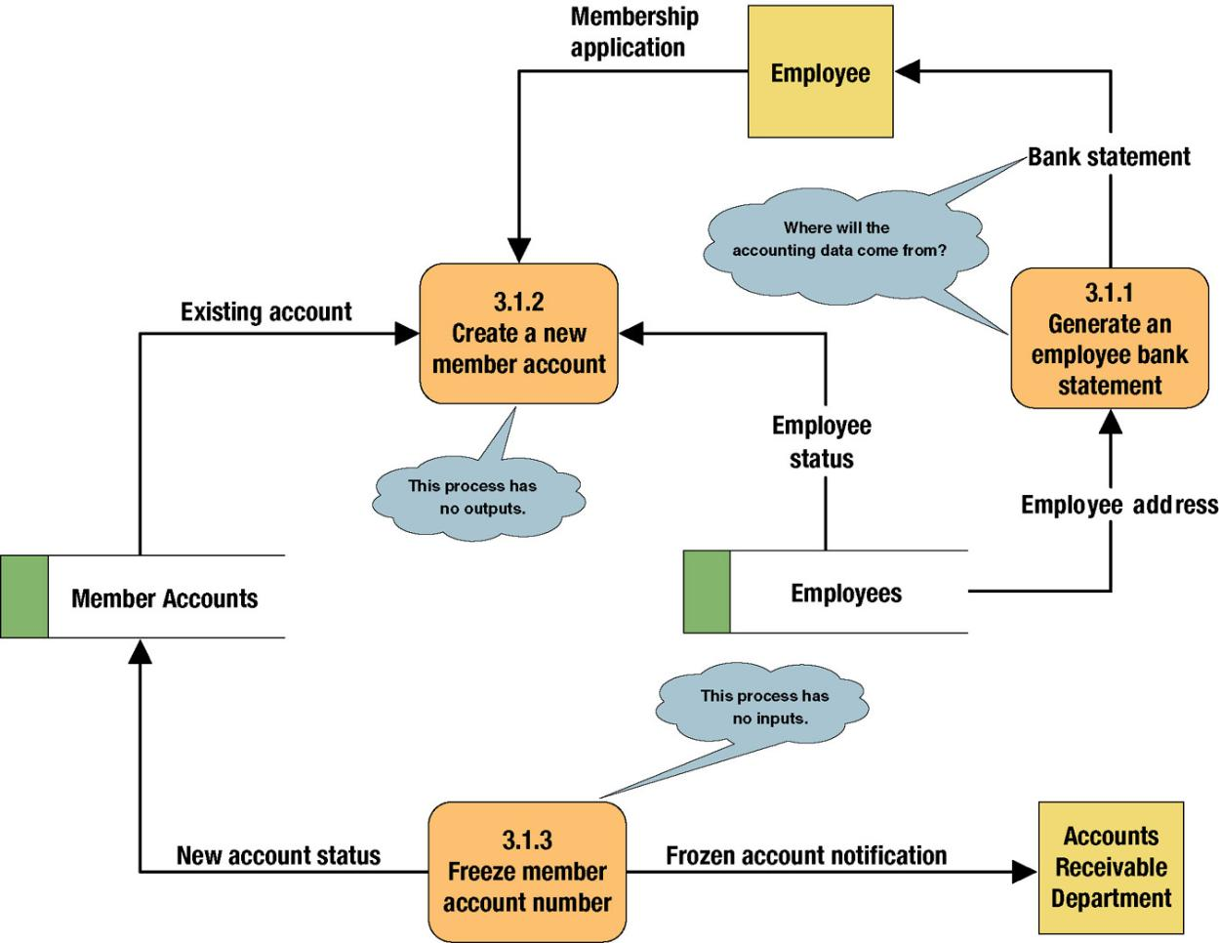
Common Process Errors on DFDs
Notes:
Teaching Notes
Idea: Correct this diagram as an in-class exercise.
3.1.1: To correct the diagram, a data flow, ACCOUNTING DATA, should be added from the data store, MEMBER ACCOUNTS, to process 3.1.1.
3.1.2: To fix the black hole, we might add an output data flow called NEW MEMBER ACCOUNT from process 3.1.2 to the data store MEMBER ACCOUNTS.
3.1.3: To fix the miracle, you would need to at least add a data flow such as ACCOUNTING DATA from the data store, MEMBER ACCOUNTS, to process 3.1.3. In all likelihood, you also need some type of triggering data flow, such as ACCOUNT FREEZE AUTHORIZATION, from a new external agent, such ACCOUNTING DEPARTMENT, to process 3.1 3.

Slide 23
Rules in DFD Building
Rule 1 : Use only DFD notations to avoid confusion
Rule 2 : Use an action VERB to label a process (because a process is an action !!!)

Slide 24
Rules in DFD Building ...
Rule 3 : Must be one process associated with each data flow …
M
M

Slide 25
Rules in DFD Building ...
Rule 3 : Must be one process associated with each data flow …
M
N
M
N

Slide 26
Rules in DFD Building ...
Rule 3 : Must be one process associated with each data flow.

Slide 27
Rules in DFD Building ...
Rule 4 : Shaded corner must appear in ALL occurrences of a duplicated symbol in a same diagram
CUSTOMER
D3
Accounts Receivable
CUSTOMER
D3
Accounts Receivable

Slide 28
Rules in DFD Building ...
Rule 5 : No process without output data flow (black hole !!!)

Slide 29
Rules in DFD Building ...
Rule 6 : No process without input data flow (miracle !!!)

Slide 30
Rules in DFD Building ...
Rule 7 : No need for routing (without transforming) a data flow with a process (non value-added activities !!!)
Info A
Info A

Slide 31
Rules in DFD Building ...
Rule 8 : Identical input, output data flows for parent and child processes (but the child processes can have their own throughputs)
  See the picture in next slide

Slide 32
Detail Rules in DFD Building ...
M
P
Context Diagram
N
M
1
2
P
3
N
Level-0 Diagram

Slide 33
Rules in DFD Building ...
Rule 9 : Data flows cannot split by themselves

Slide 34
Rules in DFD Building ...
Rule 9 : Data flows cannot split …

Slide 35
Rules in DFD Building ...
Rule 10 : A data packet can combine many data elements being transmitted at the same time to the same destination

Slide 36
Rules in DFD Building ...
Rule 11 : Double-headed arrows are forbidden [in- flow (update) and out-flow (extract info) of a data store are different]

